Slide 1
Real Estate Regression Project
Shuangtong Dai
9.13.2024

Slide 2
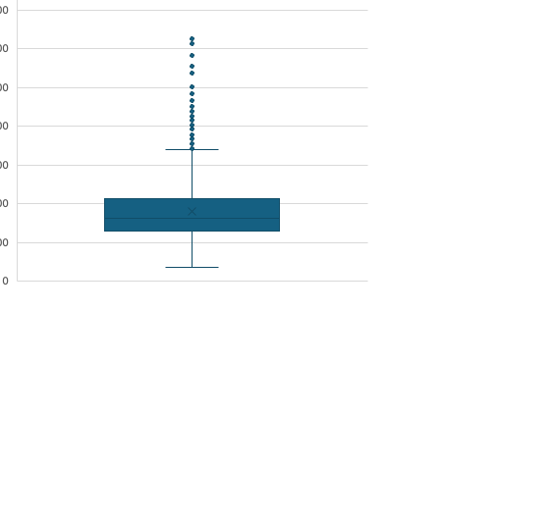
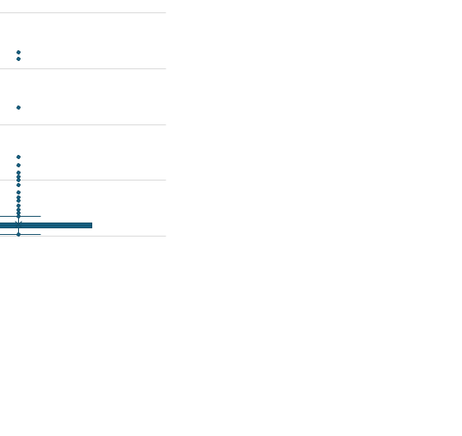
Overview of the Raw Data
1460 houses sold between 2006-2010.
Most sale prices range between 88,000.0 and 326,099, with lot areas ranging from 3,311.7 to 17,401.15 square feet.

Slide 3
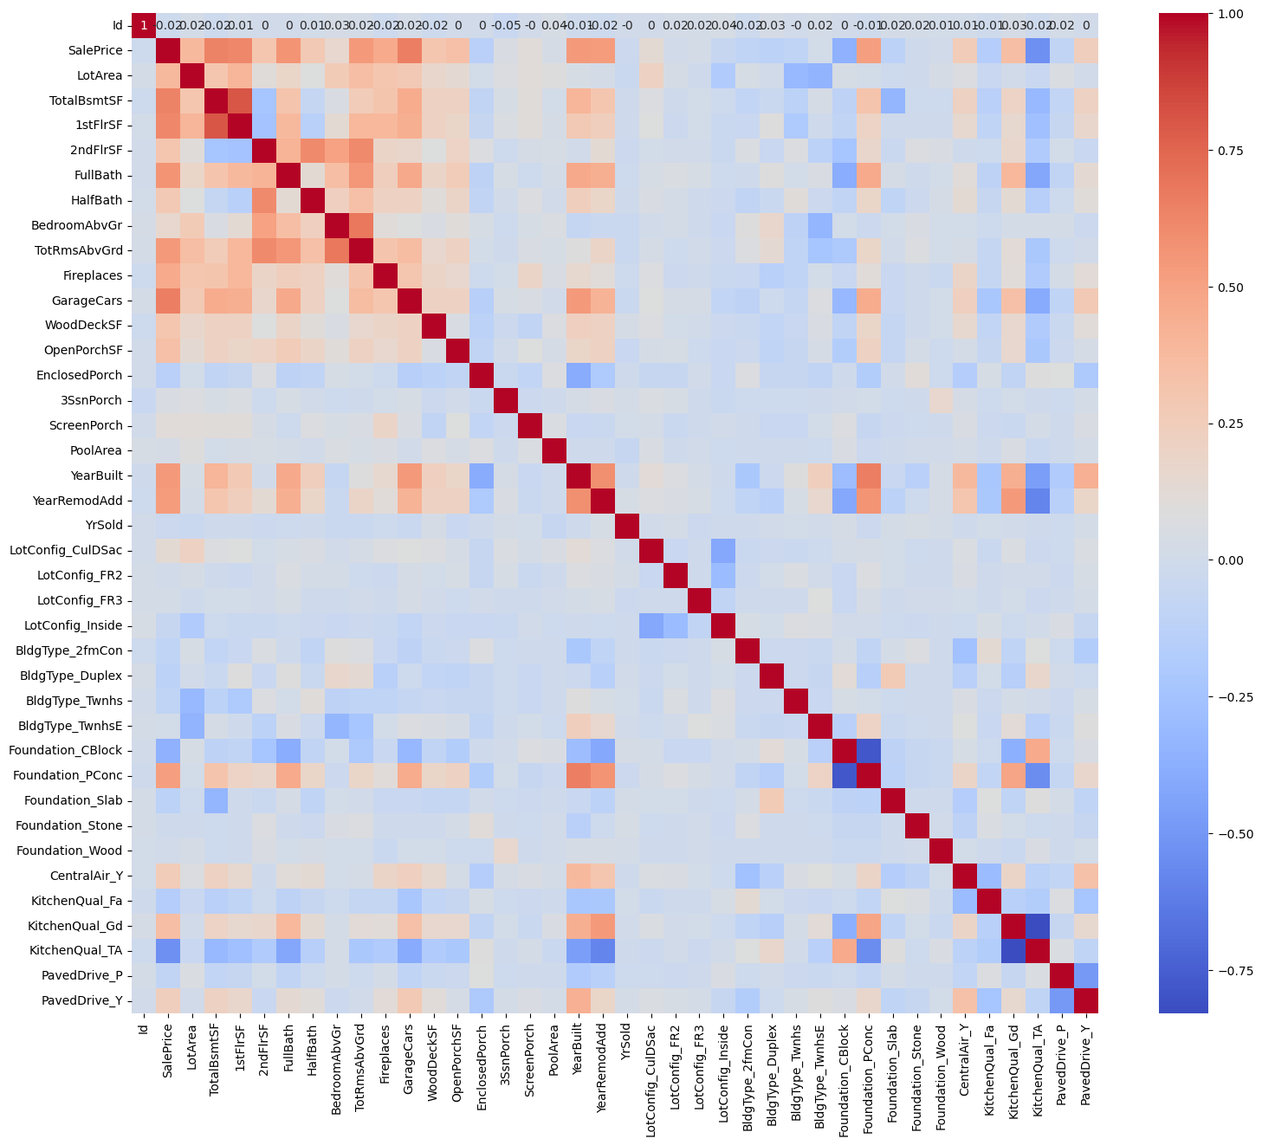
Heatmap of the Correlation Matrix
The heatmap of the correlation matrix shows the relationships between variables.
LotArea, TotalBsmtSF, 1stFlrSF, 2ndFlrSF, FullBath, HalfBath, BedroomAbvGr, TotRmsAbvGrd, Fireplaces, GarageCars, WoodDeckSF, OpenPorchSF have a high correlation with SalePrice.
Therefore, linear regression modeling is performed on these variables.

Slide 4
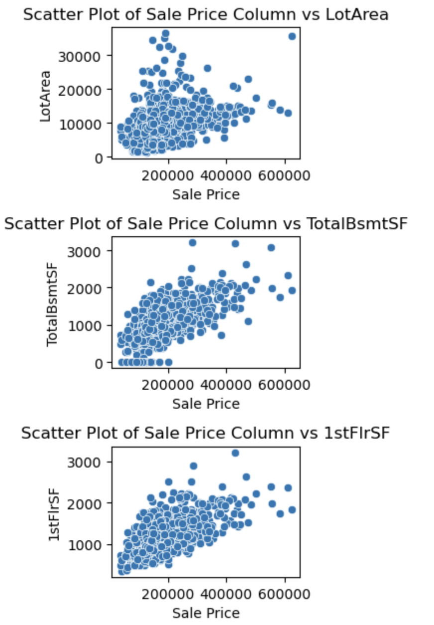
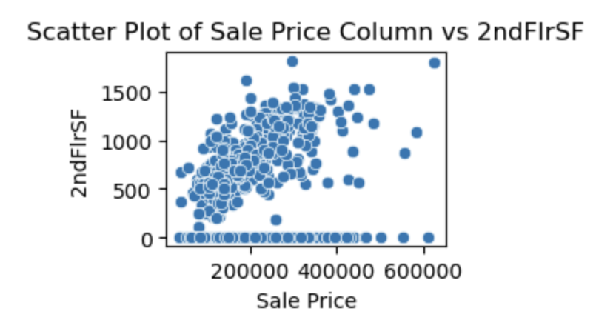
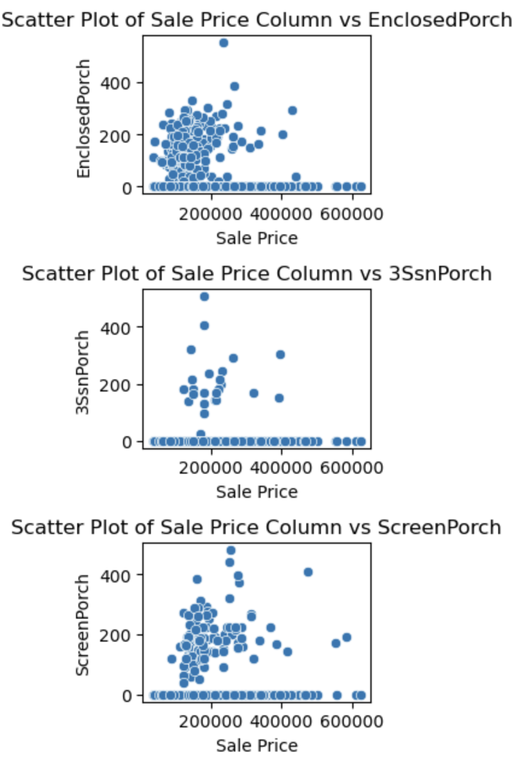
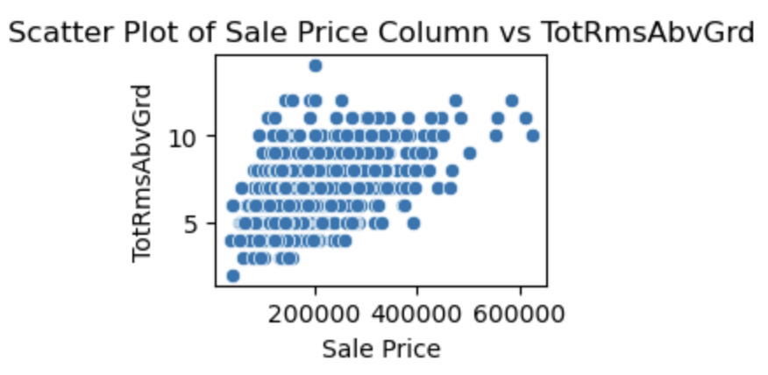
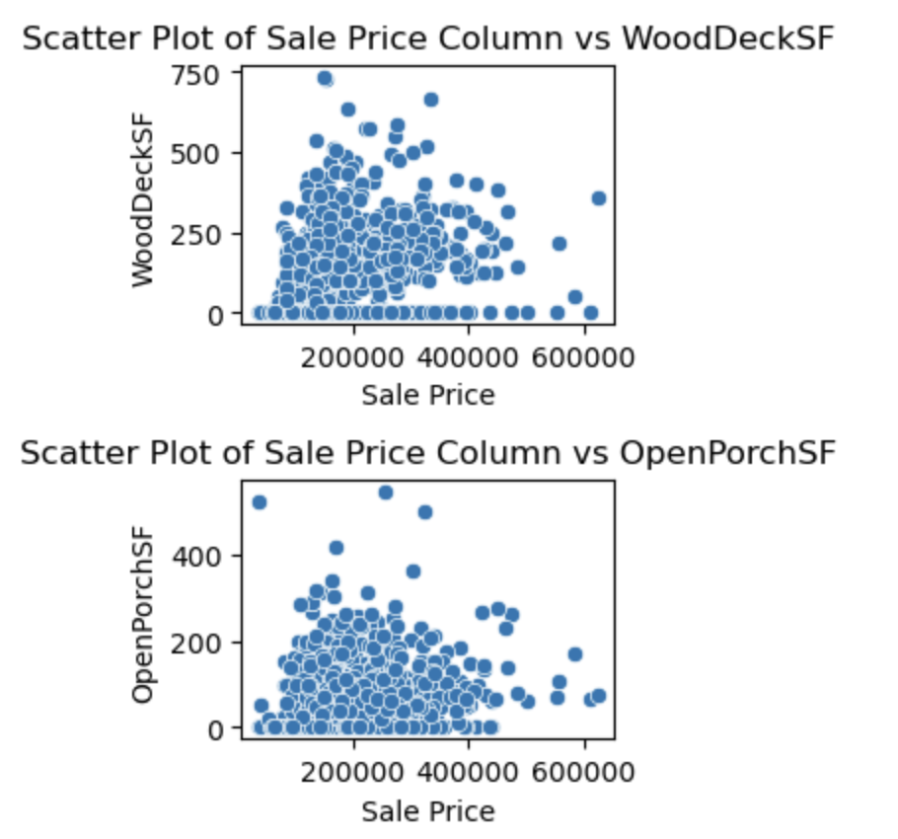
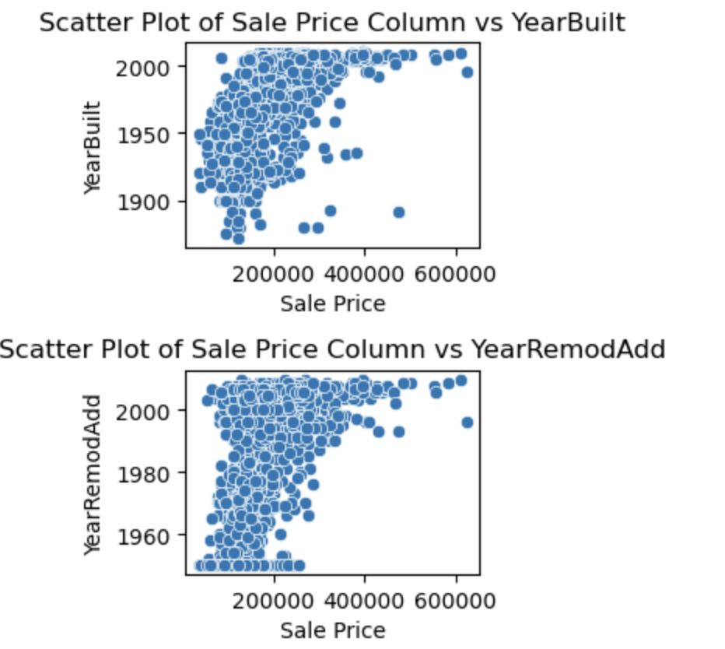
Scatter Plots of Sale Price Against Key Variables
Stepwise feature selection with significant p-values is used to add or remove features.
Scatter plots of the selected features against the target variable were created to visualize.
Stepwise feature selection, which is a method for selecting a subset of relevant features by adding or removing them based on their significance, is used to refine the model. Scatter plots of the selected features against the target variable were created to visualize the relationships and assess the strength of these correlations. With the exception of the total square footage of the three-season sunroom, the remaining features show a strong correlation with the target variable.

Slide 5
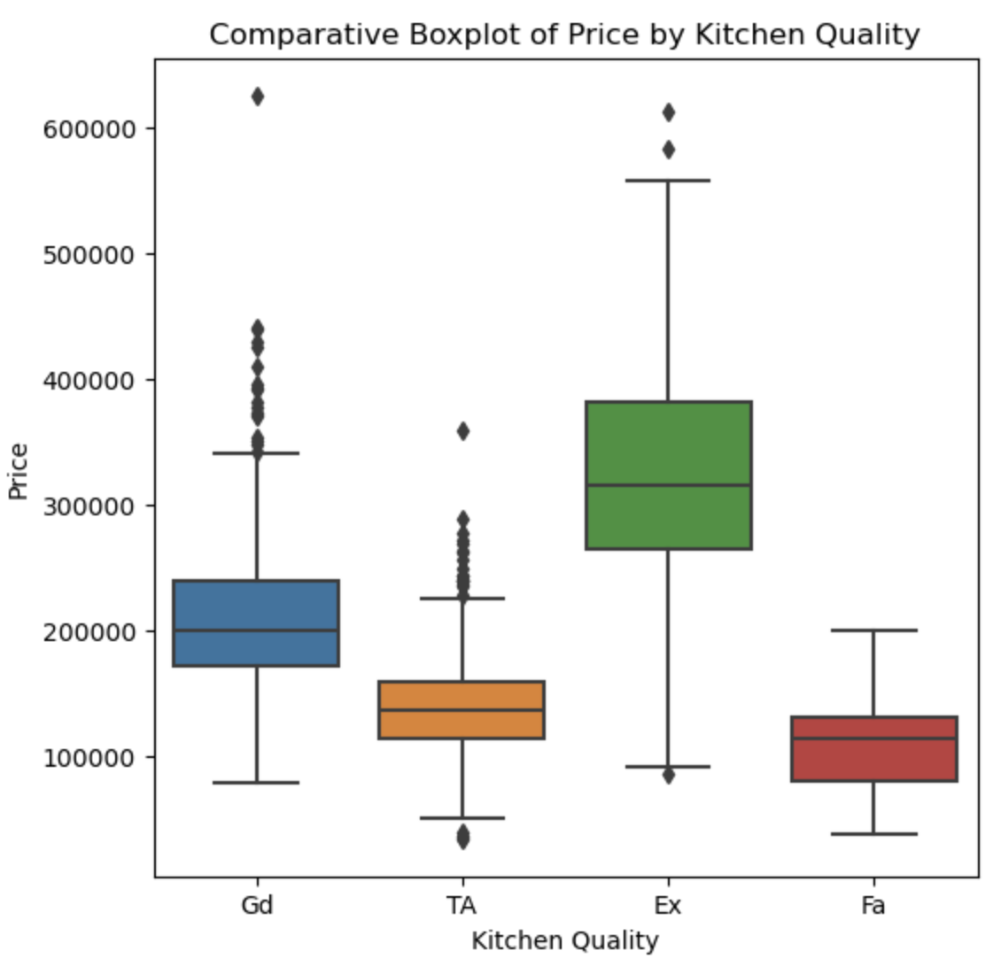
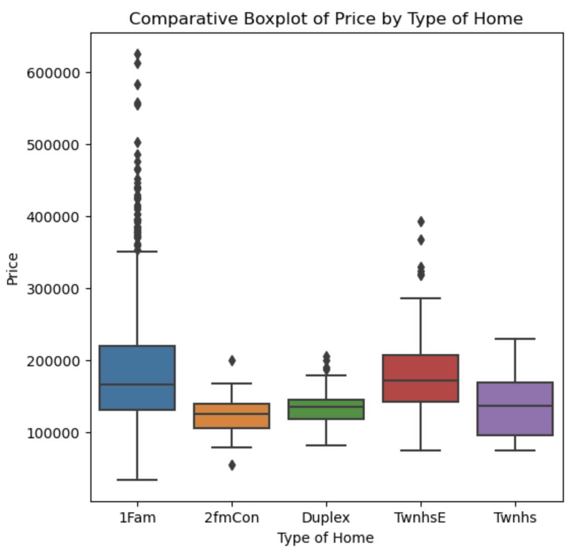
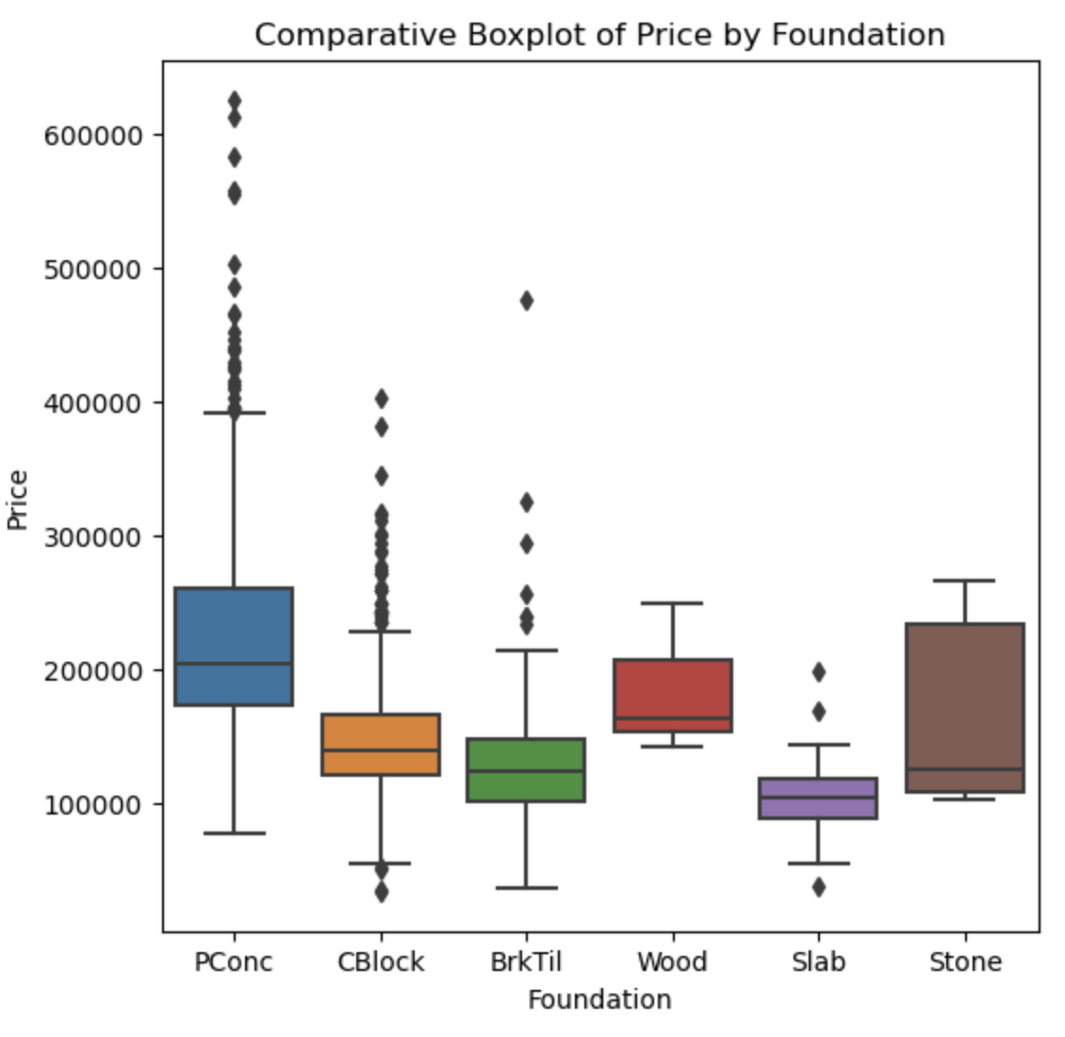
Box Plot Analysis of Selected Categorical Features
The distribution and variation of the selected categorical features with respect to the target variable.

Slide 6
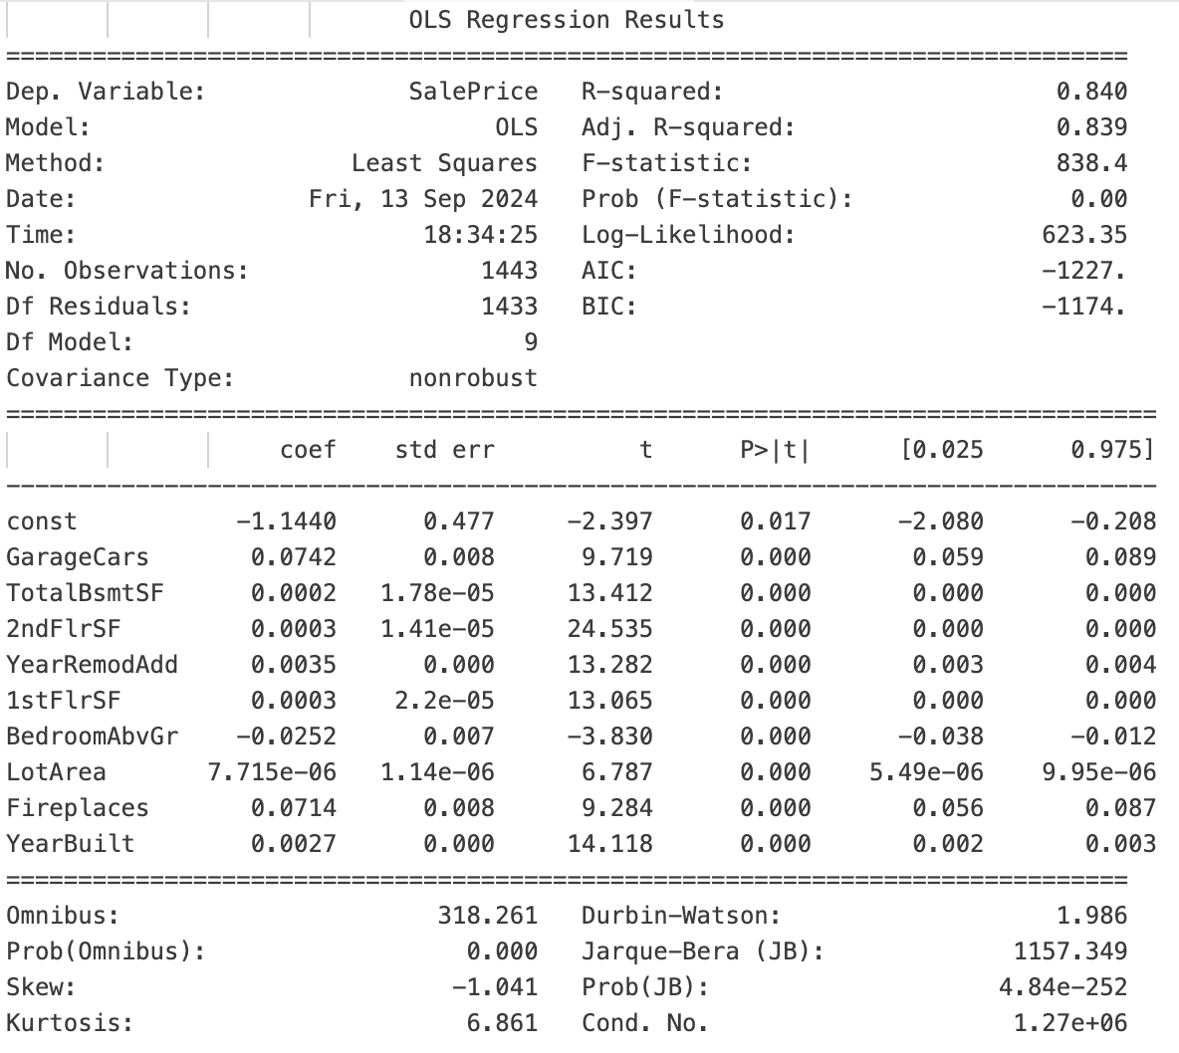
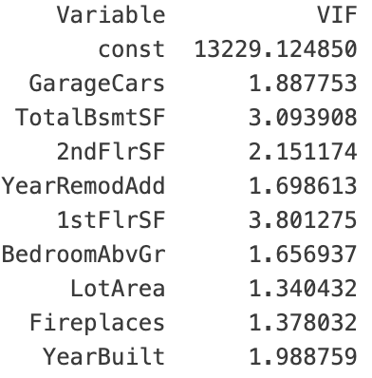
Evaluation of the Linear Regression Model
After multiple rounds of selection based on multicollinearity and p-value criteria, a final model was developed.
R-squared (0.840): Approximately 84.0% of the variance in the target variable (SalePrice) is explained by the model. This suggests a strong overall fit.
P-values: All features have p-values less than 0.05, indicating that they are statistically significant predictors of SalePrice.
Variance Inflation Factor (VIF): VIF values are generally below 5, suggesting that multicollinearity is not a major issue.
Multicollinearity happens when two or more features in a dataset are very similar or closely related to each other. This can be a problem because it makes it difficult to determine the individual effect of each feature on the outcome we're trying to predict. In other words, when features overlap too much, it can confuse the model and lead to less reliable results.

Slide 7
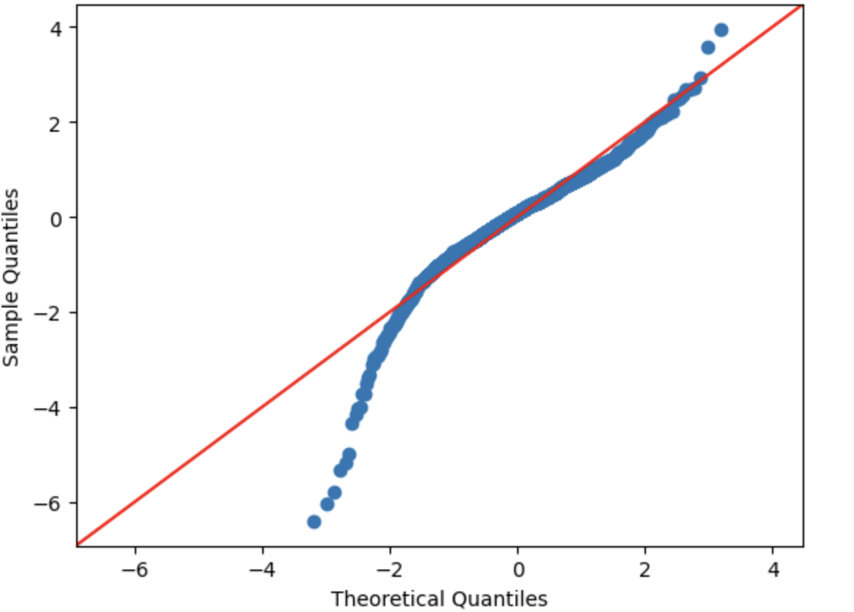
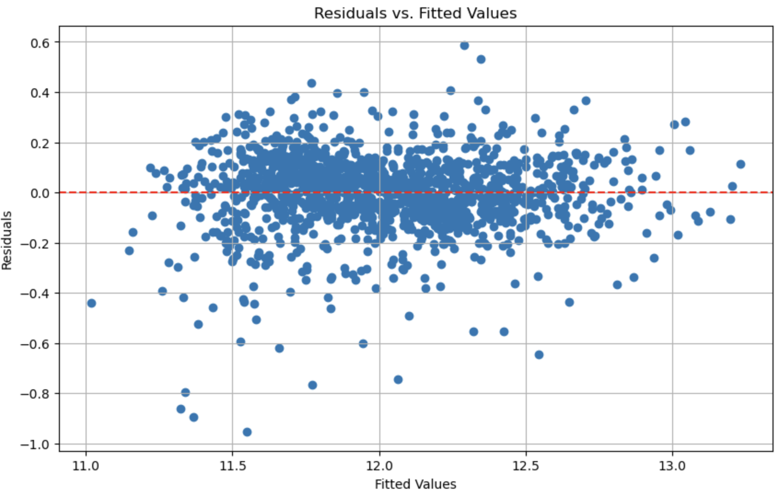
Residual Diagnostics: Q-Q Plot and Residuals vs. Fitted Values Analysis
The Q-Q plot checks the normality of residuals, while the Residuals vs. Fitted Values plot helps assess if errors are independent and have constant variance.
The Q-Q plot checks if the residuals (the differences between our predicted values and actual values) follow a normal distribution, which is a common assumption for many statistical methods. The Residuals vs. Fitted Values plot helps us see if these residuals are independent of each other and if their spread is consistent across different levels of the predicted values. In simpler terms, it helps us check if the errors (the gaps between our predictions and the actual values) behave in a predictable way and do not show any patterns that might suggest a problem with our model.
These two plots indicate that the regression model is performing well, as the residuals meet the key assumptions of normality and constant variance.

Slide 8
Recommendations for Investment
Optimize Garage Space
Enhance Basement and Floor Areas
Improve Second Floor Area
Consider Fireplace and Deck Features
Evaluate Lot and Porch Areas
Pay attention to Age and Condition
Assess Driveway and Foundation
The final linear regression model:
SalePrice = −1.1440 + 0.0742 × GarageCars + 0.0002 × TotalBsmtSF + 0.0003 × 2ndFlrSF + 0.0035 × YearRemodAdd + 0.0003 × 1stFlrSF − 0.0252 × BedroomAbvGr + 7.715 × 10^(-6) × LotArea + 0.0714 × Fireplaces + 0.0027 × YearBuilt
In the model, a positive correlation means that when one feature increases, the value we're predicting (like the sale price of a home) also tends to increase. For example, if having a larger garage or more space on the first floor is associated with higher home prices, that’s a positive correlation.

Slide 9
Predicting Real Estate Prices
These are the price predictions for five real estate properties using the linear regression model.

